Slide 1
The Book of Romans
The Righteous Shall Live by Faith
Notes:
This new series will take us all the way through to chapter 8.

Slide 2
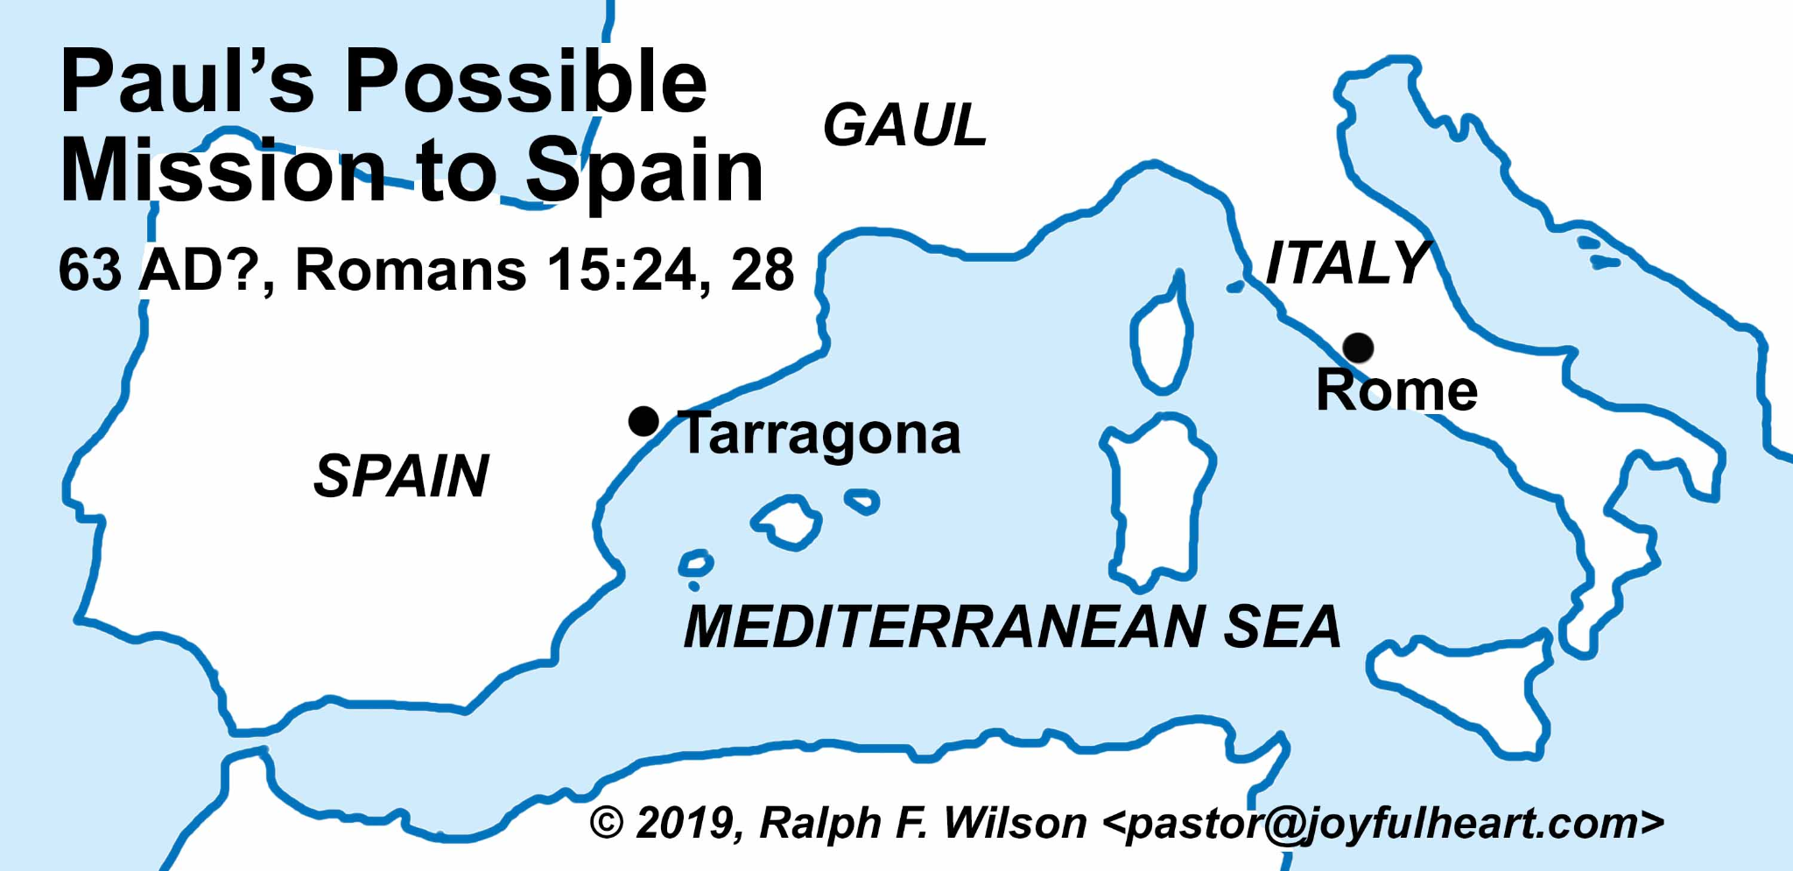
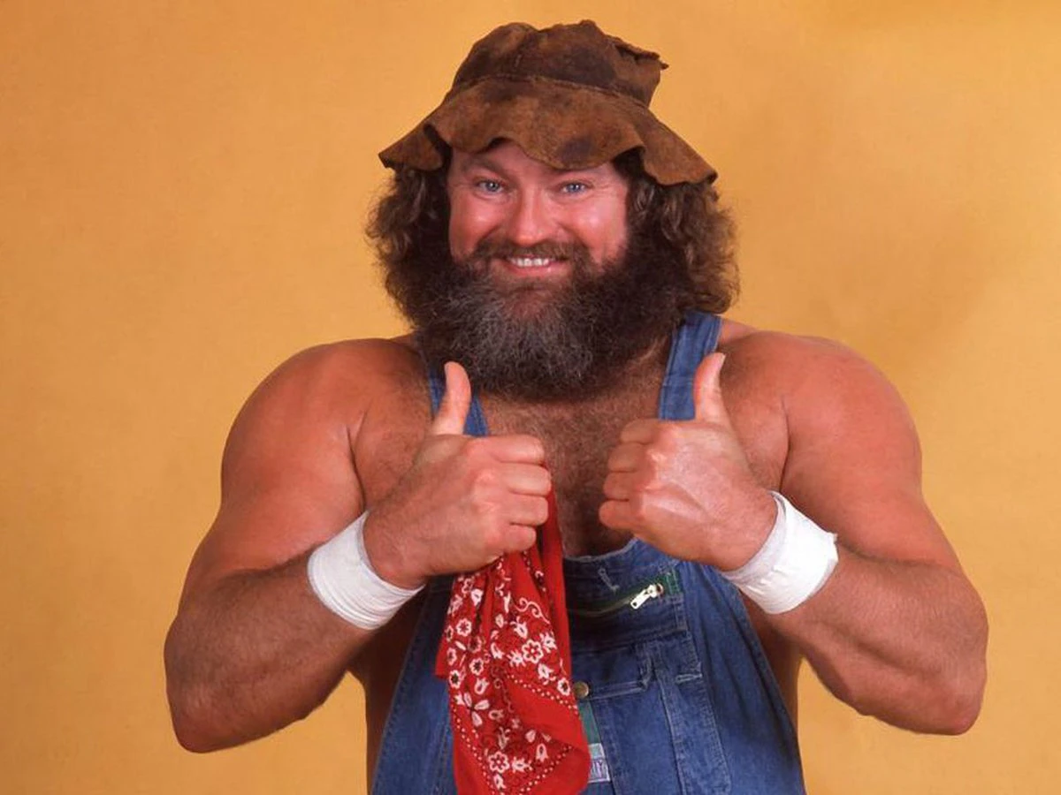
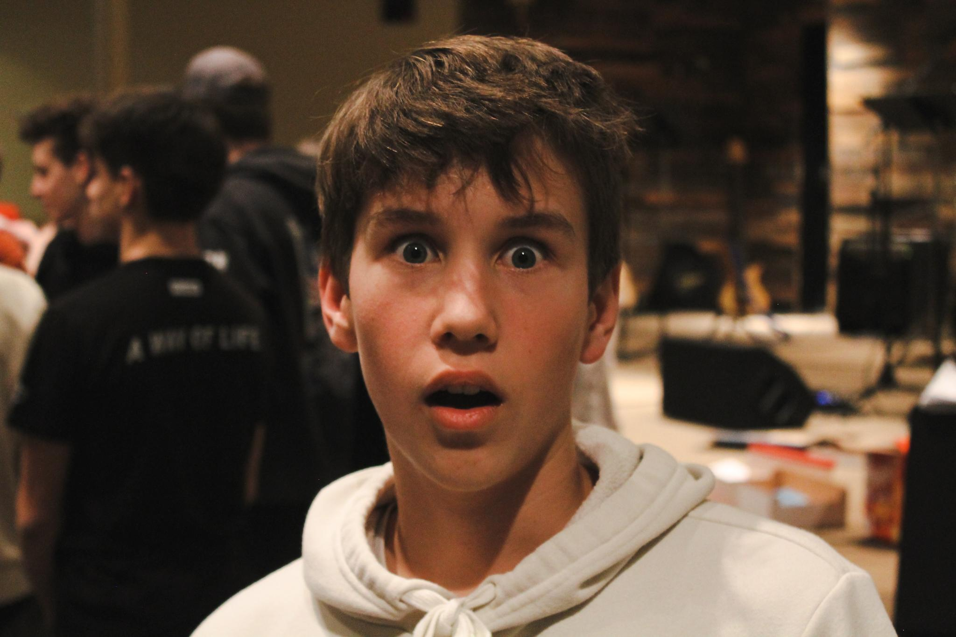
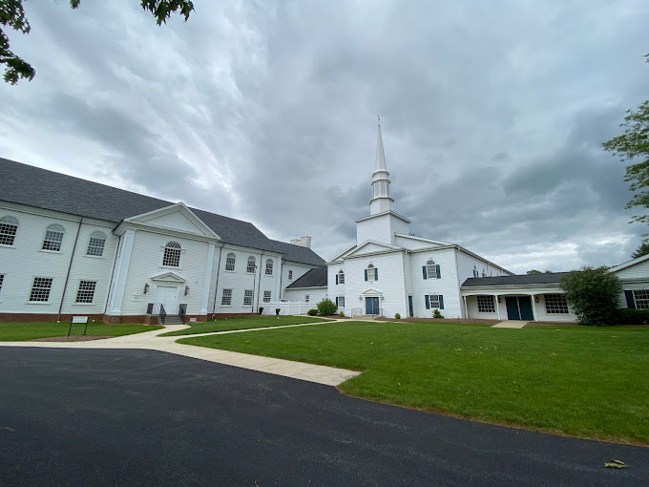
Romans 1:1-7
Paul’s Introduction to the Romans
“Allow myself to introduce… myself ”
Notes:
SLIDE 2: Introduction
Imagine with me for a moment that you’re a recent graduate from seminary, who wants to start a new church. You decide to start this new church in West Virginia, (animation) because, hey hillbillies need to hear the gospel too. But before you start this new church, you realize you need to recruit other churches to assist you financially. And so you write to a church that you’ve never been to before (animation) called Westminster Presbyterian Church to ask for their help. There’s just one problem, you’ve learned that this church is really unhealthy because it’s divided between two really large groups. These people are so divided, they can’t even agree on what the gospel is all about. There’s this one group, (animation) let’s call them the Camille’s, after their leader, who think the gospel is all about keeping rules. It’s all about eating the right way, going to church on Sunday, and trying really hard to be a really good person. But then there’s this other group in the church, (animation) let’s call them the Theo’s, after their leader, who think the gospel is all about grace for sinners. As a result, they think they have the freedom to live however they want. Now, at first, you almost don’t bother with this church, but then you start to feel bad for them, so you decide to write a letter to them, hoping you can help heal their division and have them come to a common understanding of the gospel. Now, if this were you, how would you begin that letter? What would you say?
Well, if the thought of having to do something like that seems overwhelming to you, then you will probably really appreciate the books of Romans. Because the book of Romans is a letter that the apostle Paul wrote to attempt this very thing. Like our imaginary seminary student, Paul also wanted to start a new church, except the church he wanted to start (animation) was in Spain. And in order to do that he decided to recruit the church in Rome for help. There were just two problems: One, Paul had never been to the church in Rome before. And Two, the church in Rome was divided between Jewish Christians, who thought the gospel was all about following traditions and keeping rules, and Gentile Christians, who thought the gospel meant they had the freedom to live how they wanted. And so Paul wrote this letter to the Christians in Rome to help them come to a common understanding of the gospel and to recruit their help for his new church in Spain. (See Slide #3)

Slide 3
Paul’s Introduction To The Romans
Who is Paul?
What is the gospel?
What is Paul trying to accomplish?
Notes:
SLIDE 3: Outline
Now, Paul begins his letter by answering three basic questions: The first is, (animation) Who is Paul? (remember they haven’t met him before). The second is, (animation) What is the gospel? And the third is, (animation) What is Paul trying to accomplish in writing this letter to the Romans? (See Slide #4)

Slide 4
Who is Paul?
Paul is a slave of Christ Jesus, who’s been sent to share good news that comes from God.
Notes:
SLIDE 4: Who is Paul?
Now let’s see how Paul answers that first question. In v. 1 Paul introduces himself as a servant of Christ Jesus. But the actual Greek word for servant here, is better translated as slave. So what Paul is actually saying is that he’s a slave of Christ, Jesus, which means that Paul is owned by Christ. Paul belongs to Jesus. Jesus is not simply Paul’s employer. Jesus is Paul’s master.
Now to us that may sound like a strange way to introduce yourself. I mean if Paul’s trying to impress these people so they will listen to him and help him start his new church, maybe he should try to make himself sound a little more impressive. After all, isn’t a slave the very worst thing that you can possibly be? But here’s the thing you need to understand about Roman society back in Paul’s day: If you were a slave of someone who was really important, you actually had more status and more authority than just the average free person. For example, if you were a slave of the emperor, you were a really big deal. So then, Paul's status and reputation really depends on who Christ is. And Paul is going to explain who Christ is very shortly.
But before he does, Paul also tells us that Jesus called him to be his apostle. Now, an apostle is like an ambassador. It means Paul’s been given a special message to share on behalf of a greater power. And in Paul’s case the message he’s been given is the gospel of God. Who here can tell me what the word “gospel” means? That’s right, it means good news. So when Paul says he’s been set apart for the gospel of God, he means he’s been given the authority to share good news that comes from God. And so now we know who Paul is. (animation) Paul is a slave of Christ Jesus, who’s been sent to share good news that comes from God. (See Slide #5)

Slide 5
God’s Old Testament Promise
“I will raise up for David a righteous Branch (Descendent), and he shall reign as king and deal wisely, and shall execute justice and righteousness in the land. In his days Judah will be saved and Israel will dwell securely.”
Jeremiah 23:5-6
Notes:
SLIDE 5:
Next, Paul tells us in v. 2 that this good news is the fulfillment of an Old Testament promise. In the book of Jeremiah, the Lord had promised his people, (animation) saying “I will raise up for David a righteous Branch (Descendent), and he shall reign as king and deal wisely, and shall execute justice and righteousness in the land. In his days Judah will be saved and Israel will dwell securely (Jeremiah 23:5-6).” In this passage God is promising his people that he will send a Descendent of David to save them from their enemies and give them peace. And this Savior will reign as king with wisdom, justice, and righteousness forever. And now in his letter to the Romans, Paul is letting us know that this promise has been fulfilled by God’s own Son. But who exactly is God’s Son? (See Slide #6)

Slide 6
Who is God’s Son?
The Son of God is the same in substance and equal in power and glory with God the Father and God the Holy Spirit. These three are one God.
WSC Q/A #6
The Son of God is a Spirit that is infinite, eternal, and unchangeable, in his being wisdom, power, holiness, justice, goodness, and truth.
WSC Q/A #4
Notes:
SLIDE 6: Who is God’s Son?
God’s Son is a reference to the Second Person of the Trinity, who according to the WSC, (animation) is the same in substance and equal in power and glory with God the Father and God the Holy Spirit. These three are one God. (animation) The WSC also describes this Son of God as a Spirit that is infinite, eternal, and unchangeable, in his being wisdom, power, holiness, justice, goodness, and truth. And it’s this Son of God who was born into King David’s family as the baby to Mary and Joseph. (Pause and reflect)
But why would the immortal Son of God become a mere mortal Son of David? Why would he humble himself like that? (See Slide #7)

Slide 7
Why did the Son of God become Son of David?
“The Son of [God] came not to be served, but to serve and to give his life as a ransom for many.”
Mark 10:45
Notes:
SLIDE 7: Why Would the Son of God humble himself?
Mark 10:45 tells us that he came “Not to be served, but to serve and to give his life as a ransom for many.” What’s a ransom? A ransom is usually a sum of money that you pay in order to set a prisoner free. You see, we are all born into this world being held captive by sin and death. But in our case, no amount of money could ever set us free. Instead, the Son of God had to become a man and pay our ransom with his life.
(See Slide #8)

Slide 8
What is the gospel?
The Son of God has set us free from the power of sin and death and now rules over all things for our good.
Notes:
SLIDE 8: What is the gospel?
But the really good news is that this Son of David did not stay dead. In v. 4 Paul tells us that the Holy Spirit, the third person of the Trinity, raised the Son of David from the dead and declared him to be Son of God in power. In other words, the Holy Spirit raised him from the dead, and seated him at the right hand of God the Father in the heavenly places, where he, who is both, the Son of David and Son of God, now rules as king over all creation (Eph. 1:20-22) to make sure that all things work together for the good of his people (Rom. 8:28). And that’s the gospel. (animation) The gospel is the good news that the Son of God has set us free from the power of sin and death and now rules over all things for our good.
Next, at the very end of v. 4, Paul tells us that this Son of God is none other than Jesus Christ, our Lord. And so now we know who Paul’s master is. Now we know who Christ is. Jesus is not just a king of some little country somewhere. Paul’s master is the supreme ruler over the entire universe. And because Paul is his slave, Paul actually has more value, honor, and dignity than any so-called “free person”. And notice that Paul says that Jesus is our Lord, which means that he wants the Christians in Rome to know that if they belong to Christ, then they too have a great amount of value, honor, and dignity. (See Slide #9)

Slide 9
What is Paul trying to accomplish?
To make the Roman Christians slaves of Jesus Christ
Notes:
Slide 9: What is Paul trying to accomplish?
But the question still remains, what is Paul’s goal in writing this letter? What is he trying to accomplish? In v. 5 Paul tells us that his mission is to bring about the obedience of faith among all the nations… and that this includes the Christians in Rome as well. But what exactly does this phrase, “the obedience faith”, mean? Well, let’s think about what faith is for a second. Faith is the act of believing and trusting in Christ for your salvation. In other words, it’s admitting to yourself and to God that you don’t have what it takes to live on your own. It’s admitting that you are a broken and helpless person who needs Jesus to be made whole again. It’s admitting that you need Jesus to help you live rightly. It’s admitting that you need Jesus to save you from your sin. In other words, faith is really the act of self rejection and complete reliance on Jesus Christ.
So when Paul talks about the obedience of faith, what he’s really talking about is giving your heart and soul to Christ. It’s the act of enslaving yourself to the person of Jesus. And so Paul’s mission is really to make more and more slaves of Jesus Christ. That’s why he’s writing. (animation) Paul is writing to the Roman Church to make them slaves of Christ.
And the Roman Christians needed to hear this because although they had professed faith in Christ, they hadn’t yet surrendered their hearts and souls completely to Christ. One half thought they could still contribute to their salvation by doing the right thing. And the other half thought that since they were already saved, they were now free to live how they wanted. But slaves don’t do either of those things. Slaves don’t save themselves and slaves don’t live how they want. Slaves are saved by their master and slaves only live how their master wants them to.
And slaves don’t ask the question: what do I have to do to make my master happy today? Nor do they ask the question: what can I get away with and still have my master be happy with me? Instead, slaves who’ve surrendered their heart and souls to Christ simply delight in the very same things that their master delights in. And they count it their joy and privilege to serve their master. (See Slide #10)

Slide 10
Are you a slave of Jesus Christ, our Lord?
Notes:
SLIDE 10: Application
And so my question for all of us tonight is this: Are you a slave of Jesus Christ, our Lord? I suspect we all have a really easy time professing faith in Christ. Saying that you believe in Jesus is like saying you believe in Santa Claus. It’s easy and it doesn’t necessarily mean anything. But it’s much more difficult to surrender yourself to Christ and become his slave. But that’s what it really means to be a Christian. And that’s what Paul wants for us. So let’s pray now and ask God for his help.

